Slide 1
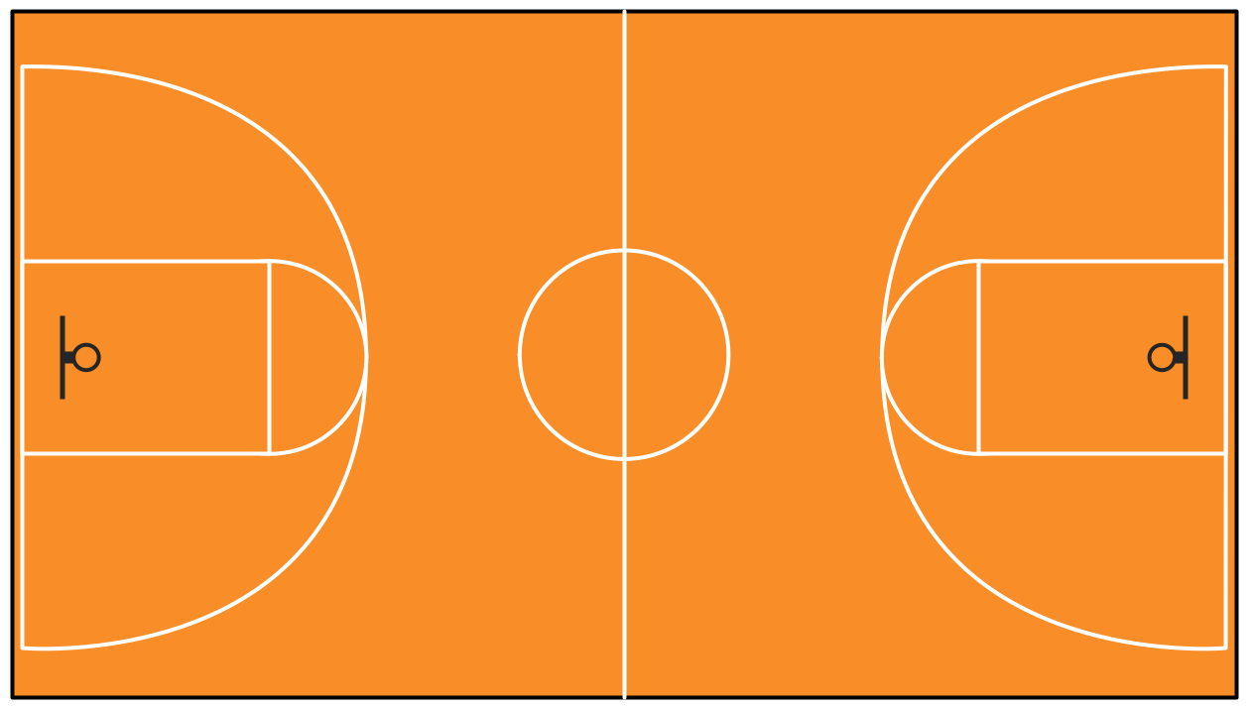
NBA Make-A-Team
UCBerkeley Data-X
Vikram Singh | Dian Yu | Karl Walter | Francis Yang | Dong-Eun Suh
Project Github Link:
https://github.com/karlwalter/nbaproj_ieor

Slide 2
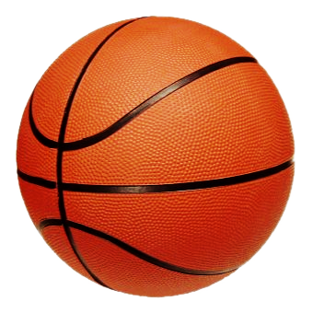
1
1
Introduction : Problem and Objective
2
1
Project Evolution : Methodology & Project Management
3
1
Our Solution
4
Learning Path
1
5
UI and Demo + Future Development
1

Slide 3
Introduction

Slide 4




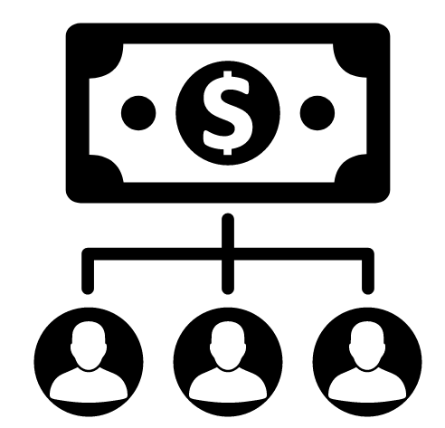
Problem Statement
This project used relevant NBA team & player statistics to predict a hypothetical team’s winning percentage.
Mentor: Sampath Duddu (Berkeley Ventures)
Primary Project Components:
1. Data aggregation and preprocessing
2. Train model based on team & player statistics to
predict wins
3. UI allowing users to create their own team and,
using appropriate model, output predicted wins
ALGORITHM
Notes:
At the beginning of the semester, Iklaq had said some team may work for real world problems and some may work for some cool stuffs. Our team is more entertainment oriented. We are playing around NBA teams and players’ statistics such as rebounds and assists to develop some entertainment oriented application for fun. We wanted to produce a application that users can make their own team and get an accurate prediction on the team performance. Our mentor is sampath Duddu from Berkeley Ventures.
So our project included three main tasks of Data aggregation and preprocessing, making winning percentage model, and the user interface for the ‘Make-A-Team’ users.

Slide 5

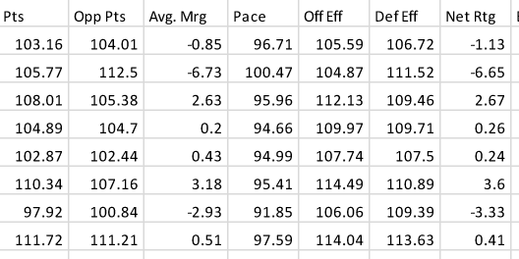

Project Objective
Our potential users would be all the basketball fans, including coaches and managers,
but our main target is to make Make-A-Team as an entertaining mobile game so as to enable everyone to enjoy it.
Prediction model with the help of existing stats for NBA teams
Filter
Reinventing the input variables to
indicate ‘team dynamics’
Predicting the success rate of hypothetical teams
Notes:
Potential users would be all the basketball fans, so our oriented goal is to make ‘Make-A-Team’ as an entertaining game which everyone can enjoy it.

Slide 6
Methodology
Notes:
Dian :

Slide 7
Methodology
Data Preprocessing
Web Scraping
Features Selection
Winning Percentage Model
Regression
Suggested Player Swap Model
Machine Learning
Functions Integration
User Interface
UI Design (pyqt5)
Call Function
1
Literature Review / Features Research
Model Development
UI Development
2
Win % Model
3
Data Collection
Features Engineering
Model Integration
Application UI
4
Player Swap Model
5
Notes:
Our project can be mainly divided into 3 sections: data/feature selection , Model development & UI Development
First we played around with the data for a while and brainstorm on what kind of features will benefit
Then we spent a lot of time developing models and train and test the accuracy

Slide 8
Project Evolution Chart
Task | Assigned To | Oct. |  |  |  | Nov. |  |  |  | Dec.
 |  | Week 1 | Week 2 | Week 3 | Week 4 | Week 5 | Week 6 | Week 7 | Week 8 | Week 9
 |  | 10/9/17 | 10/16/17 | 10/23/17 | 10/30/17 | 11/6/17 | 11/13/17 | 11/20/17 | 11/27/17 | 12/4/17
Brainstorm on potential outputs | All
Reach out to Mentor & former team member | Dian, Karl
Setup a github | Karl
Data Preparation
Data Collection | Yuanzhe
Data Sorting | Dian
Data Preprocessing | Vikram, Dian
Data Analysis
Winning Percentage Prediction Model | Vikram
Player Swap | Karl
Integrated Application | Vikram
User Interface
UI Design | Dian
Call Function Between Model & UI | Yuanzhe
Documentation
Final Write-up Report | All
Final Presentation Wrap Up | Dong-Eun
Final Presentation | All

Slide 9
Our Solution !
Notes:
Francis :

Slide 10
System Architecture
Data Inputs
Feature Generation
Algorithms / Model
Output
Cumulative Team Statistics
Within Team Dynamic Ratios
Winning % Model
Win %
Player Statistics
Across Team Performance Ratios
Player Swap Model
Player Swap, Features Analysis
Web Scraping, CSV
Pandas/Numpy
Scikit-learn
(Linear regression)
UI - pyqt5
Player Data Input
Data Warehouse
Models & Algorithm
Data Output
…
User Interface
(Make-A-Team)
Notes:
Upper part:
Backstage algorithm development
Application:
Input - Backstage Algorithms (Win % model & Player model)- Output to UI

Slide 11
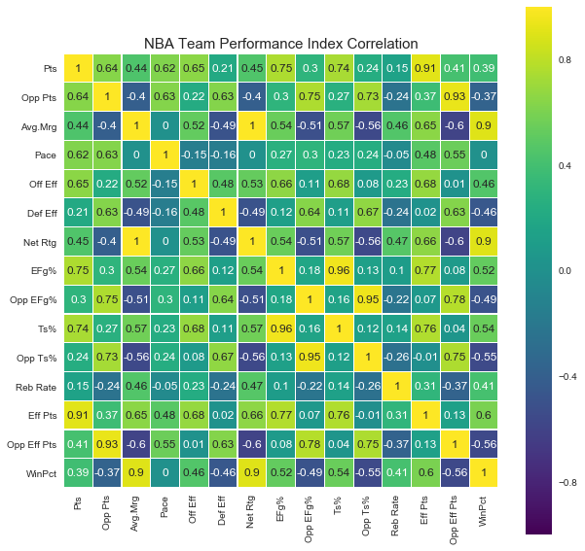
Data Preprocessing
Web Scraping
Data sources
NBA Miner: https://www.basketball-reference.com/
Methods
Python web scraping package: Beautifulsoup
Pandas
Features Exploration
Methods:
Performance Indices Correlation
Sklearn (regression, knn, xgboost, random forest, etc.)
RFE: recursive feature elimination
'Off Eff' 'Def Eff' 'Net Rtg'
Notes:
Vikram

Slide 12
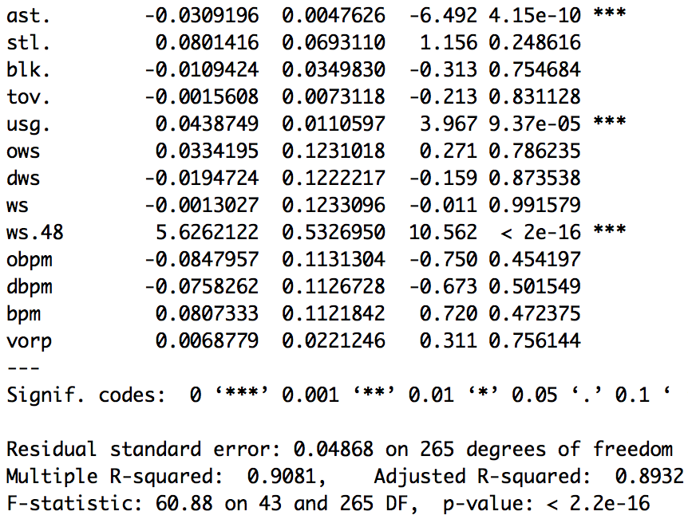
Feature Selection & Generation
Raw statistics specific to a player versus statistics related to team
Include: Points, rebounds, assists etc.
Exclude: Pace, defense/offense rating, arena
Advanced player composite statistics
PER, Ast %, WS/48, USG%
Custom team dynamic statistics
PER ratio across players on selected teams
1
2
3
Notes:
Vikram

Slide 13
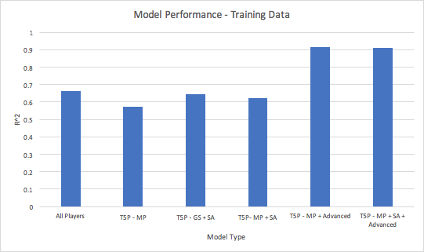
Developing Winning Percentage Model
All Players per team
Top 5 Players per team, by minutes played (MP)
Top 5 Players per team, by games started (GS)
Top 5 Players per team, by MP & normalized by season average (SA)
Top 5 Players per team, by GS & normalized by SA
Top 5 Players per team, by MP + advanced stats
Top 5 Players per team, by MP + advanced stats & normalized by SA
Notes:
Vikram

Slide 14
Developing Swap Model
1
2
Statistic (5-player) | μ | σ
2-pointers | 1453 | 280
rebounds | 1964 | 355
steals | 363 | 64
Get top 5 players for each team. Get mean and standard deviation for each statistic.
After players are selected, assign z-score in each statistical category for selected team.
→ Lowest z-scores = weakest areas
→ Highest z-scores = strongest areas
3
4
Impose desired restrictions on swap
→ Salary Cap On?
→ Percentage of Salary Cap?
MAKE SWAPS: Iterate through players in the league, swapping with selected players. Recalculate sum z-scores of worst three statistics.
⇒ Determine which swap results in the largest increase in the weakest categories (while complying with restrictions)
Notes:
Karl :

Slide 15
Learning Path
Notes:
Francis :

Slide 16
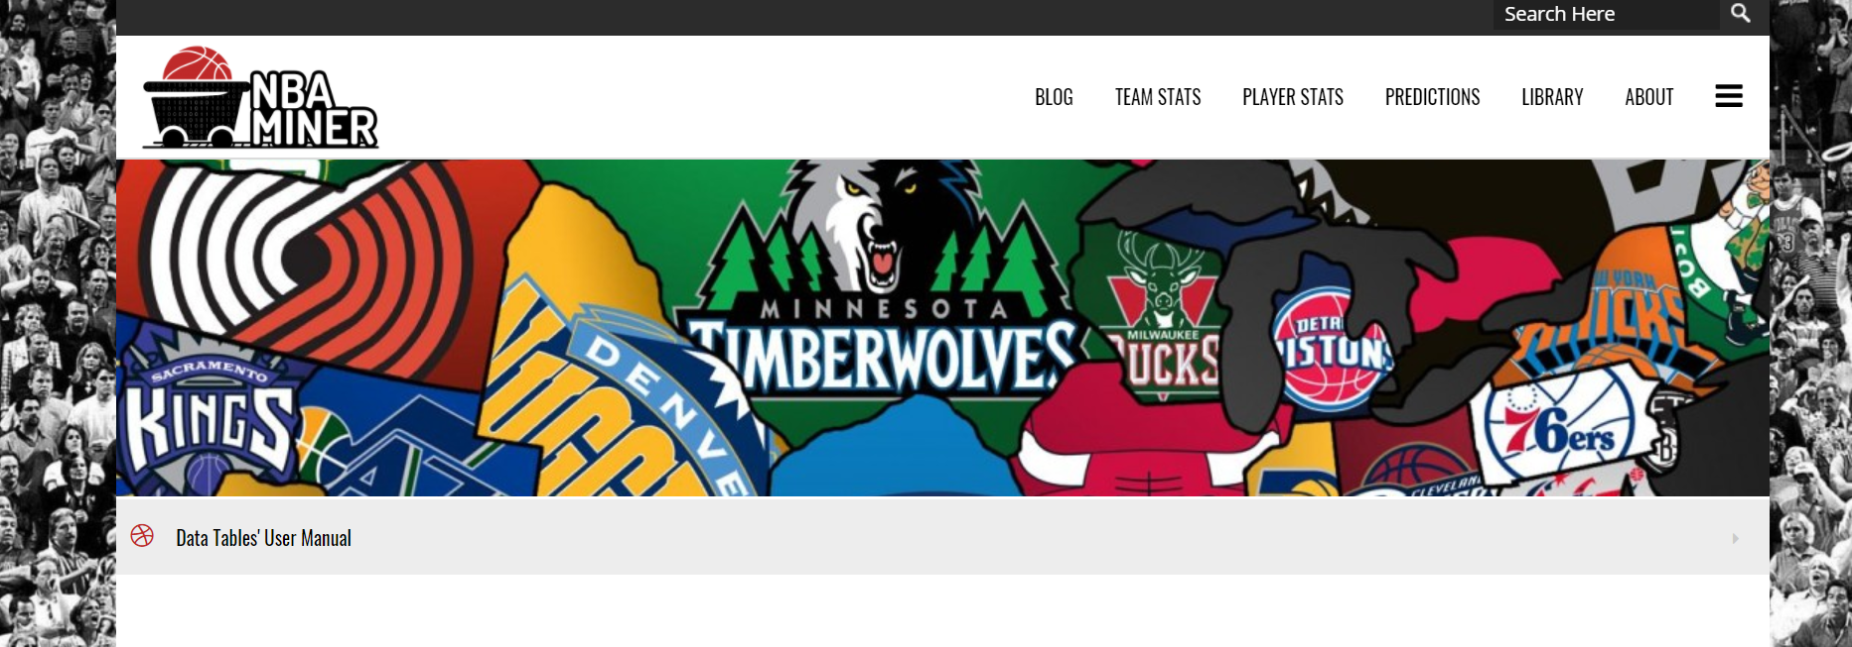
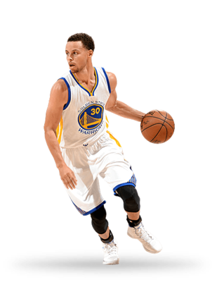
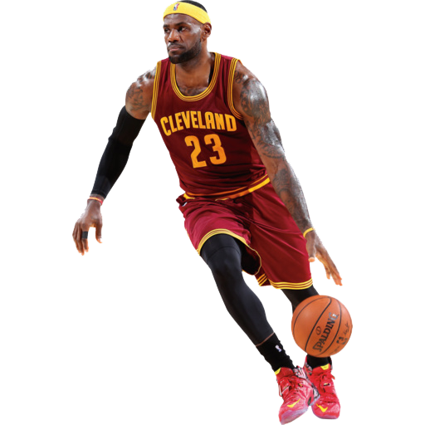
Idea Generating
Old Topic: Automatic Material Recycling
New Idea: NBA Data Analysis
Reasons:
Full and free data available
Large space of flexibility
No basketball expert necessary
Discussion:
Figure out the aspects that affect team performance mostly
Predict the winning percentage of an imaginary team of desired players
Analyze team dynamic to give suggestions

Slide 17
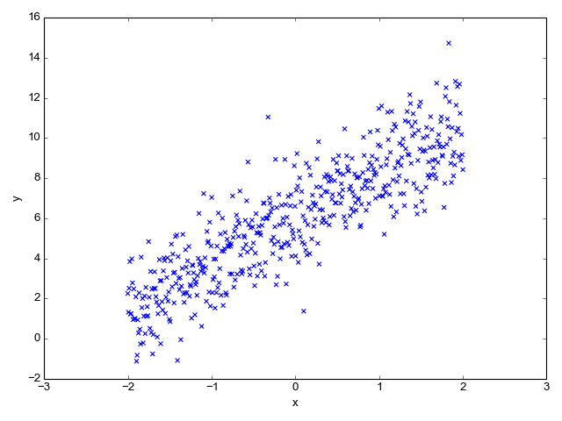
Model Development
ML Model From Class
Linear Regression
Features Selection & Comparison
Final Model
Notes:
Dian :

Slide 18
User Interface
PyGUI
Pyforms
Tkinter
PyQt
Comparatively easier but works only for Unix, Macintosh, and Windows platforms. Considering that we have Mac system, we decided to switch soon after.
Based on a ControlBase object, it provides a quite comprehensive set of controls, which includes functions from PyQt, OpenGL, and others. However, we decided to switch because it’s uneasy to be set, and unstable to be operated.
TKinter is the standard GUI library for Python, which means it’s been included in Python when installed. However, coding a window is not as easy as just drawing out one. So we decided to switch after several days of trial.
The Toolkit could be downloaded and it’s convenient to design the interface as we wish. After creating the main window, it could convert the file to be a pyscript, and program the functions for it.

Slide 19
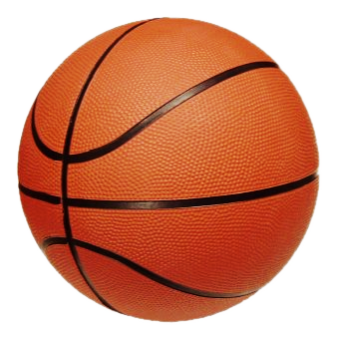
Demo

Slide 20
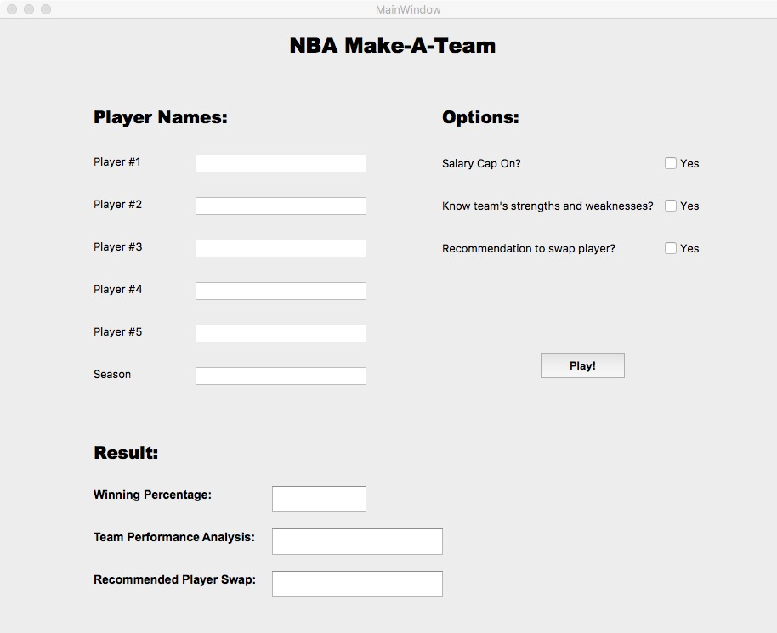
User Interface: Prototype
Features
1
Case insensitive of input
Error Message that indicates which input is invalid
2
3
More information available by clicking the checkbox
Notes:
Karl

Slide 21
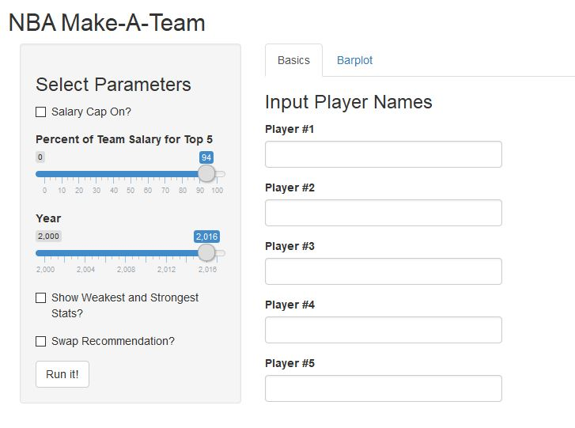
User Interface: End Product
Instructions:
Input 5 desired players
Check for validity
Click Run It!
Check the options
Follow the advice to switch players for improvement
Notes:
Karl

Slide 22
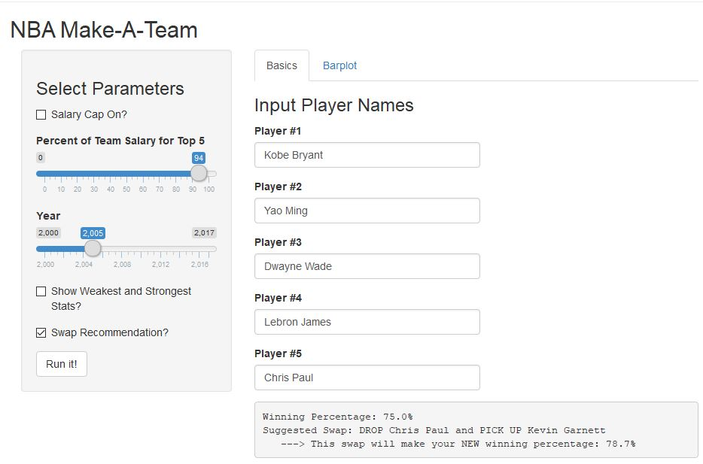
User Interface: Scenario 1
Scenario Description:
→ Past “All-Star” team
Notes:
Karl

Slide 23
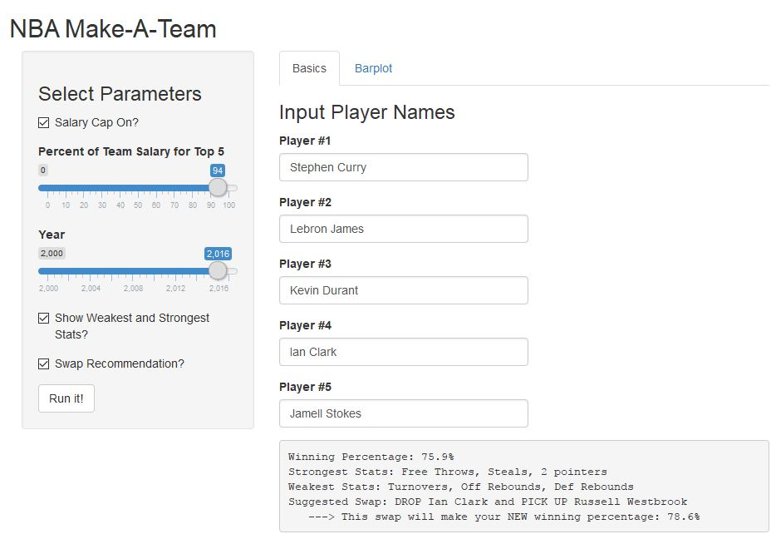
User Interface: Scenario 2
Scenario Description:
→ 3 great players and 2 mediocre players
Notes:
Karl

Slide 24
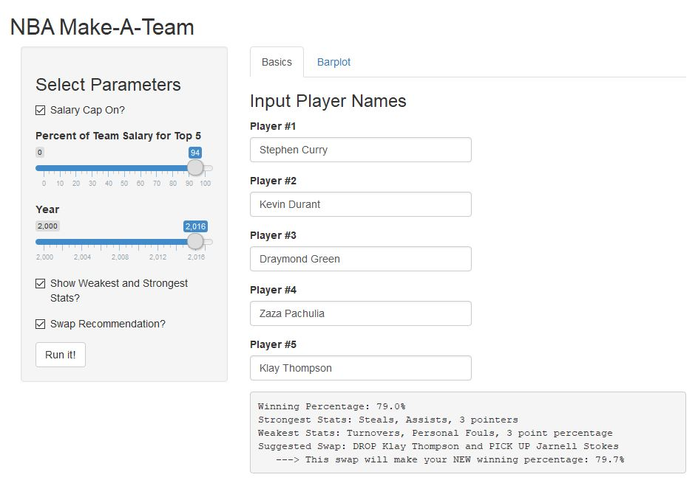
User Interface: Scenario 3
Scenario Description:
→ 2016 Warriors starting 5
Predicted Winning Percentage:
79.0%
Actual Winning Percentage:
81.7%
Predicted Winning Pct: 79.0%
Actual Winning Pct:
81.7%
Notes:
Karl

Slide 25
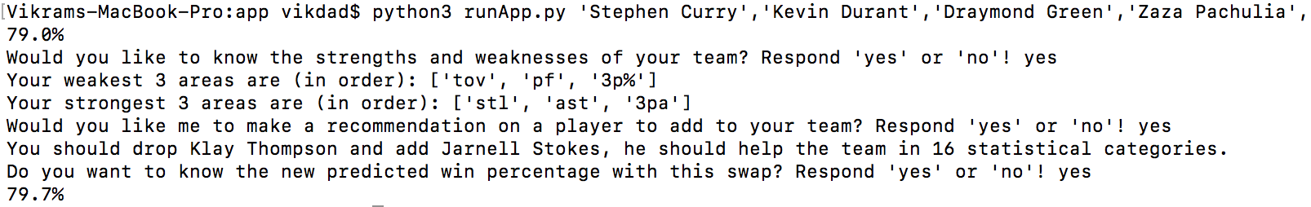
Demo code
Notes:
Karl

Slide 26

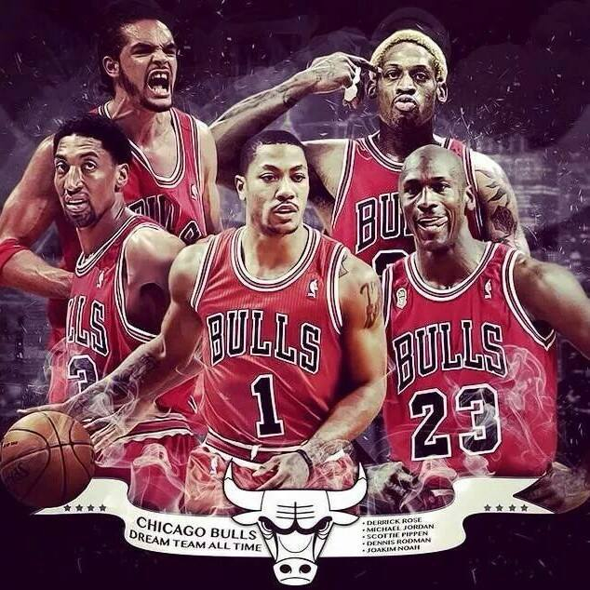
Future Development
Notes:
Vikram

Slide 27
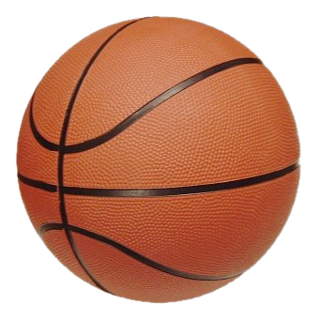
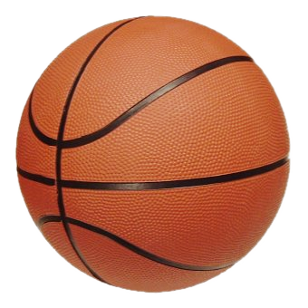
Thank You
For Listening !

Slide 28
NBA Make-A-Team
UCBerkeley Data-X
Vikram Singh | Dian Yu | Karl Walter | Yuanzhe Yang | Dong-Eun Suh
Project Github Link:
https://github.com/karlwalter/nbaproj_ieor

